Slide 1

Final Engagement
Attack, Defense & Analysis of a Vulnerable Network
Notes:
TRISH

Slide 2
Table of Contents
This document contains the following resources:
Network Topology & Critical Vulnerabilities
Exploits Used
Methods Used to Avoid Detection
Notes:
TRISH

Slide 3

Network Topology
& Critical Vulnerabilities
‹#›

Slide 4
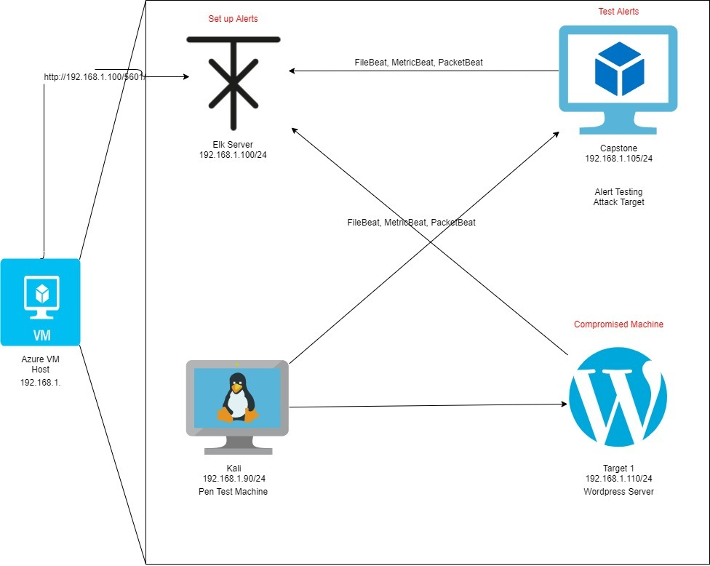
Network Topology
Network
Address Range: 192.168.1.1/24
Netmask: 255.255.255.0
Gateway: 10.0.0.1
Machines
IPv4: 192.168.1.90
OS: Kali
Hostname: Kali (Attacker)
IPv4: 192.168.1.110
OS: Linux
Hostname: Target 1
IPv4: 192.168.1.105
OS: Linux
Hostname: Capstone
IPv4: 192.168.1.100
OS: ELK
Hostname: Elk Server

Slide 5

Critical Vulnerabilities: Target 1
Our assessment uncovered the following critical vulnerabilities in Target 1.
Vulnerability | Description | Impact
Public access to port 22 | Open and unsecured access | Servers with port 22 open are prone to brute-force attacks
MySQL is not secure, full access | Easily brute forced. Anyone can access data | database username, password, hostname, and the ability to create a database.
Weak name and passwords | Attacker can use numerous names and password combinations to gain access | Attackers gain access to data. Cause monetary, reputational, and operational risks.

Slide 6

Exploits Used
‹#›

Slide 7
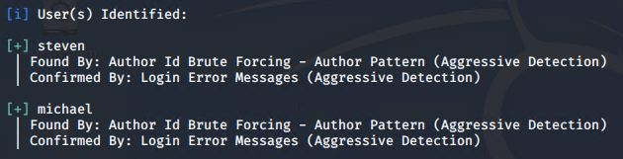
Exploitation: [Open port 22]
Summarize the following:
How did you exploit the vulnerability?
nmap -sV 192.168.1.110
wpscan --url http://192.168.1.110/wordpress -eu
What did the exploit achieve? Found two user accounts
Notes:
BEN

Slide 8
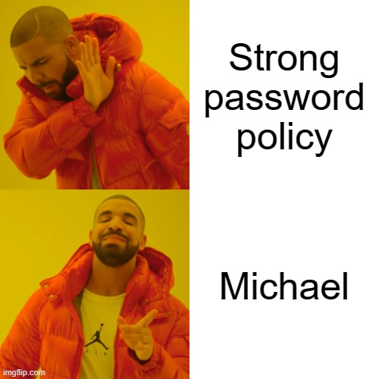
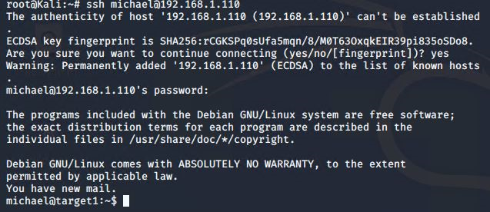
Exploitation: [Weak passwords and usernames]
Summarize the following:
How did you exploit the vulnerability?
ssh michael@192.168.1.110
Guessed Michael’s password
What did the exploit achieve? Gained shell access
Notes:
BEN

Slide 9
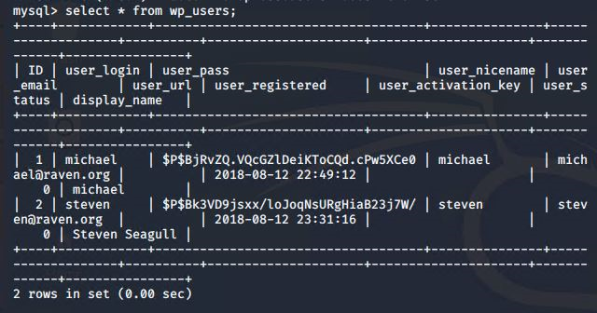
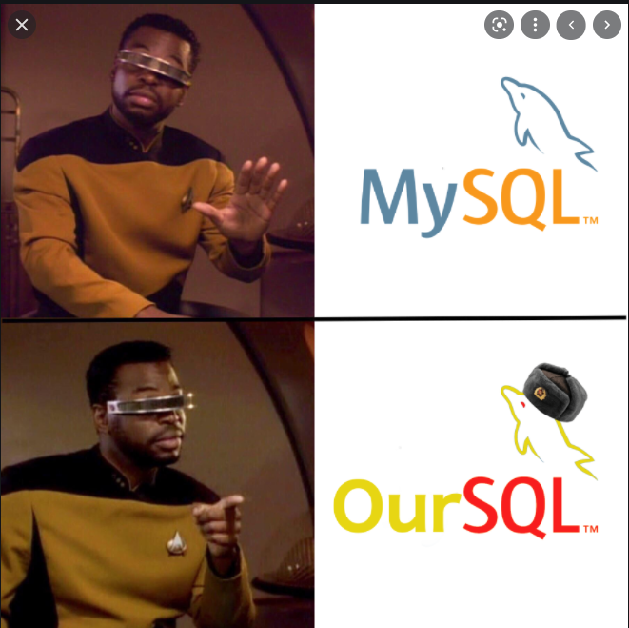
Exploitation: [MySQL Access]
Summarize the following:
How did you exploit the vulnerability?
cat /var/www/html/wordpress/wp-config.php
What did the exploit achieve? Found hashes for Steve and Michael
Notes:
GARRET

Slide 10
Avoiding Detection
‹#›

Slide 11
Stealth Exploitation of [Port 22 Access]
Monitoring Overview
Which alerts detect this exploit? Port Scan alert, non-whitelisted IP alert, TCP scan
Which metrics do they measure? Packets being sent, increase in network traffic
Which thresholds do they fire at? 3500 or above in a 1 minute
Mitigating Detection
How can you execute the same exploit without triggering the alert?
nmap -f scan which does 100 scans
Are there alternative exploits that may perform better?
--top -ports does less than 100
timing template min -rtt-timeout and max-rtt-timeout
Notes:
GARRET

Slide 12
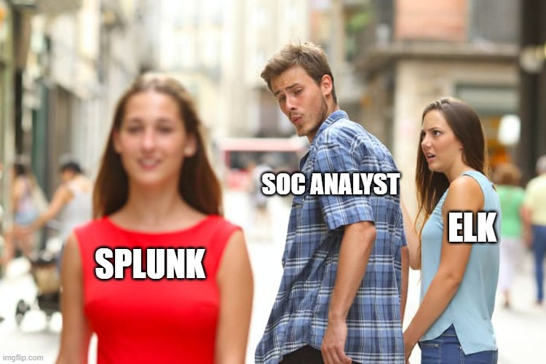
Stealth Exploitation of [Weak Passwords and Usernames]
Monitoring Overview
Which alerts detect this exploit? 401 alarm, increase in traffic, increase in http requests
Which metrics do they measure? http errors and requests
Which thresholds do they fire at? 10 failed login attempts within an hour
Mitigating Detection
How can you execute the same exploit without triggering the alert?
No
Are there alternative exploits that may perform better?
Phishing
Hydra
Notes:
TRISH

Slide 13
Stealth Exploitation of [Unsecured MySQL]
Monitoring Overview
Which alerts detect this exploit? unauthorized access
Which metrics do they measure? “GET” request
Which thresholds do they fire at? 5 or more requests per hour
Mitigating Detection
How can you execute the same exploit without
triggering the alert?
Are there alternative exploits that may perform better?
Metasploit
SQL injections
Notes:
TRISH

